Slide 1

Useful QI principles for NELA
Dr. Carolyn Johnston
Consultant anaesthetist
NELA QI lead

Slide 2
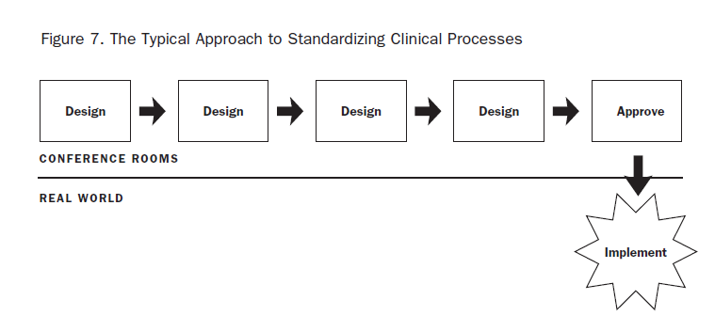
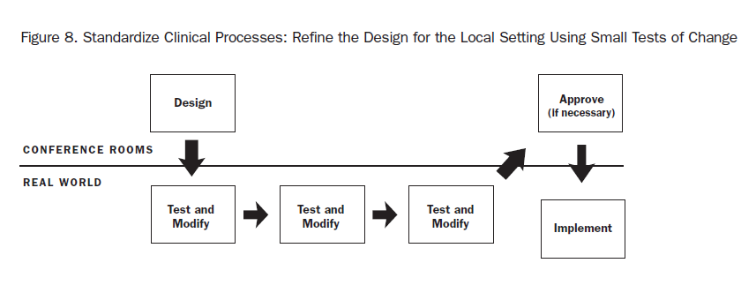
The Typical Approach
Reinertsen JL, Bisognano M, Pugh MD. Seven Leadership Leverage Points for Organization-Level Improvement in Health Care (Second Edition). Cambridge, Massachusetts: Institute for Healthcare Improvement; 2008. Available: www.ihi.org p26
Applied Science Approach

Slide 3
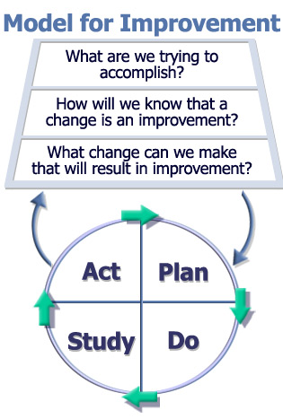
Model for Improvement
Act on the plan - Testing
Notes:
3

Slide 4
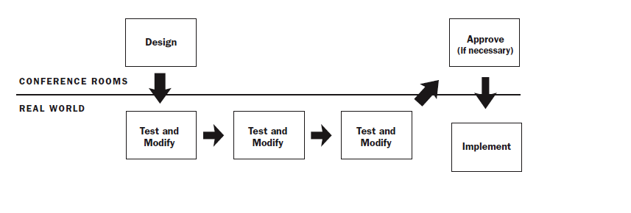
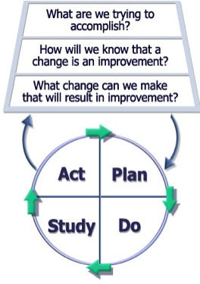
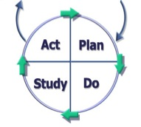
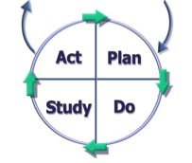
Applied Science Approach

Slide 5
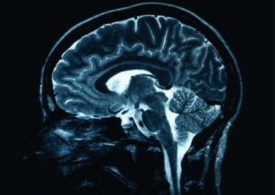

Model for Improvement
Act on the plan - Testing
Aim
Measures
Changes
Implementation
Notes:
5

Slide 6
Model for Improvement
Act on the plan - Testing
Notes:
6

Slide 7
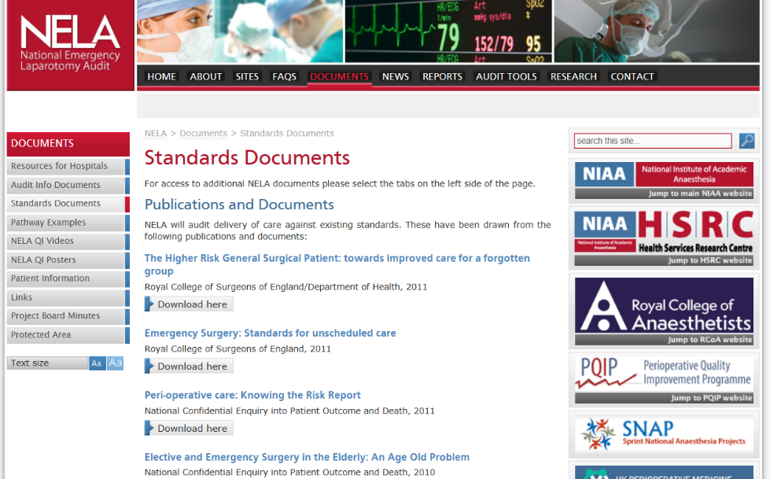
What is your aim?
NELA standards come from consensus documents
Might decide other local aims based on need

Slide 8
Model for Improvement
Act on the plan - Testing
Notes:
8

Slide 9
Model for Improvement
Act on the plan - Testing
Notes:
9

Slide 10

Quality Improvement:
What changes can we make that will result in an improvement?

Slide 11
Understanding your system:
Driver Diagrams
Process Mapping
Co Design (with patients or staff)

Slide 12
Driver Diagrams
Aim
Primary Driver – Primary things that would cause this outcome or aim
Secondary Drivers – Drive the primary drivers – multiple influencers, dashed line
Then identify the measures of each concepts
Notes:
12

Slide 13

Primary Drivers
Secondary Drivers
Aim
Key factors that
will
influence the aim
Secondary factors which will influence delivery of the primary drivers
What?
How much?
By when?
Secondary factors which will influence delivery of the primary drivers
Secondary factors which will influence delivery of the primary drivers
Notes:
This is how a driver diagram is visualised
Primary Drivers
Key factors which you need to influence in order to move towards the aim. These drivers may act independently or together to achieve the overall goal.
Secondary Drivers
Underpinning factors affecting the associated primary driver(s). They can be used to create projects or a change package that will affect the primary drivers.
Change Ideas
The ideas you will take forward to test with PDSAs that directly support delivery of the secondary drivers
13

Slide 14
Breakout
Next:
Create a driver diagram for improving emergency laparotomy length of stay
Spend 10 minutes in tables
Notes:
GET SOME LARGE POST-ITS and FLIP CHART PAPER for DRIVER DIAGRAM

Slide 15
Process Mapping Diagram
- What is it?
Lean principle
Identify interconnected steps in a pathway
Converts information into a diagrammatic visual form
Notes:
Lean principle – key definition
15

Slide 16
What is your ‘process’?
What is ‘value’ in your process?
Is it value for the patient?
Series of connected steps or actions to achieve an outcome
a starting point and an end point – “the scope”
it is usually linked to other processes
it can be simple and short e.g. booking an emergency case, or more complex e.g. the whole laparotomy pathway
Notes:
Simple – phelbotomist taking blood
Complex – enhanced recovery following hip replacement

Slide 17
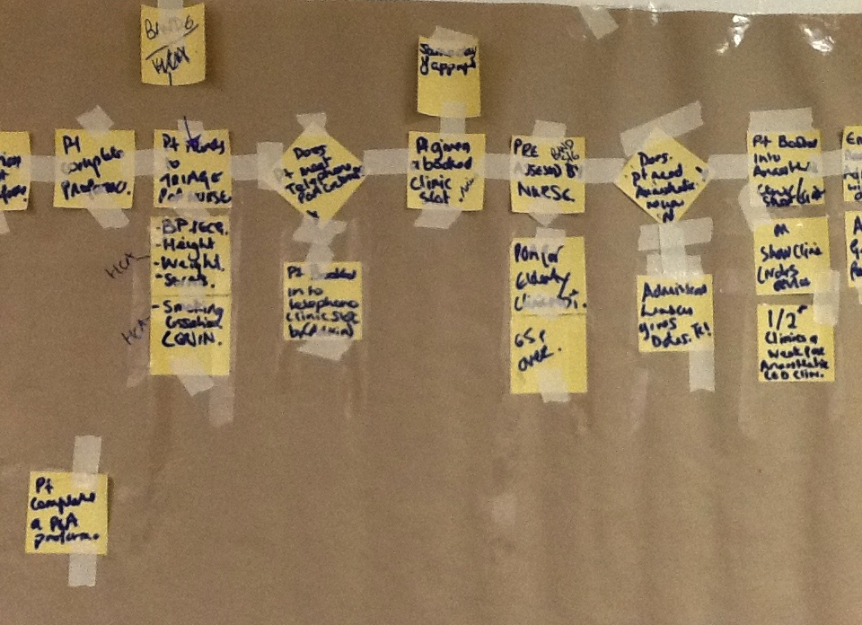
Process Mapping Diagram
Notes:
Preoperative assessment pathway project done by one of my colleagues – here a series of photos demonstrating how to construct a process mapping diagram – sat down with pre-op nurses, lead consultant and project manager to map out being referred for surgery to undergoing surgery concentrating on the pre-assessment part, and what you in reality need to improve rather than necessarily what YOU perceive to be the problem
17

Slide 18
Breakout
Write a process map for a part of the emergency laparotomy pathway at your hospital.
What parts of the process could you measure?
What parts could you change to make it more reliable or better?
Notes:
GET SOME LARGE POST-ITS and FLIP CHART PAPER for DRIVER DIAGRAM

Slide 19
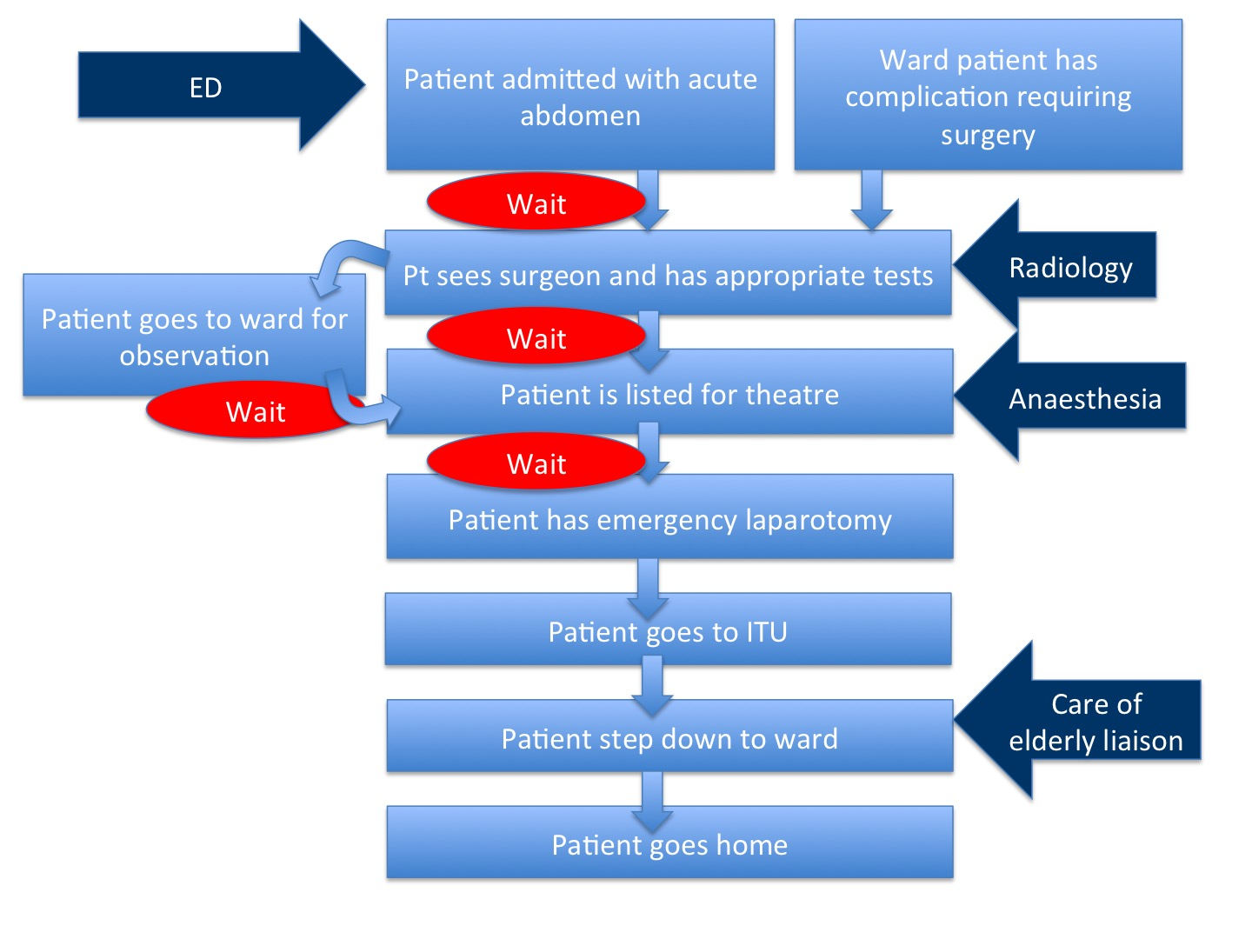
What system are you focused on?

Slide 20
Co Design
Looks at process from users point of view- i.e VALUE
Collaborative and often leads to best results
More work involved in setting up, but often more sustainable
Can include users in project team- ‘co production’
Notes:
20

Slide 21


Designing services for patients
⬇
designing services with patients

Slide 22
Model for Improvement
Act on the plan - Testing
Notes:
22

Slide 23
Why test your changes?
To learn how to adapt the change to your setting
To evaluate the costs and “side-effects” of changes e.g. business case
To increase the belief of others that the change will result in improvements in your setting

Slide 24
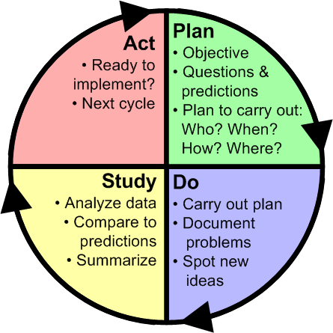
“What will happen if we try something different?”
e.g. a new booking form
“What’s next?”
Do you scale up or change your idea based on what you’ve learnt?
“Did it work?”
Check your NELA data for signs of improvement
“Let’s try it!”
Pilot the booking form for one week
Notes:
Northwest Improvement Initiative
© R. Scoville & I.H.I.

Slide 25
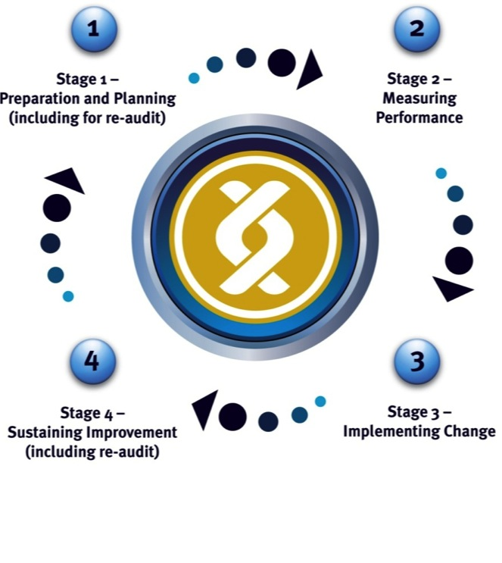
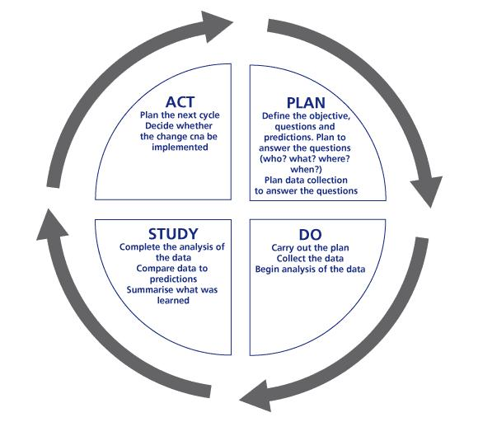
Clinical audit cycle
PDSA cycle
Implement change
Notes:
Both cycles are quality improvement tools.
Sequential dynamic process that measures clinical practice against EB benchmarks, devise strategies to improve practice and measure the impact the strategies have (re-audit). Ultimate aim is intended improvement is achieved.

Slide 26
Cycles of Tests Build Confidence
Changes that will result in improvement
Learning from data
Proposals, theories, hunches, intuition
Notes:
Northwest Improvement Initiative
© R. Scoville & I.H.I.
31

Slide 27
Summary
Model for improvement is handy framework for making change
NELA standards, measures and reporting can help you do this
There are a few simple tools to help you get change ideas e.g. driver diagrams etc.

